Slide 1
ACADEMIC RESEARCH PROJECT · MACHINE LEARNING · NLP
Mental Health Status
Classification from Social Media Posts
METHOD
DATASET
CATEGORIES
SAMPLES
TF-IDF + SVM
Kaggle – Sentiment Analysis for Mental Health
Depression · Anxiety · PTSD · Normal
5,957 anonymised social media posts
For Research & Educational Purposes Only · Not Intended for Clinical Diagnosis

Slide 2
Presentation Outline
Structure of this academic presentation
01
Problem Statement & Dataset Overview
Motivation, research gap, dataset characteristics
02
Methodology & Pipeline Diagram
Text preprocessing, TF-IDF vectorisation, SVM classification
03
Key Results, Charts & Model Comparisons
Precision, Recall, F1-Score, Specificity metrics
04
Screenshots of the Deployed Application
Live interactive demo — web interface walkthrough
05
Conclusions, Limitations & Future Work
Findings, ethical constraints, and next steps

Slide 3
Problem Statement
& Dataset Overview
01
Mental Health Status Classification from Social Media Posts

Slide 4
Problem Statement
Why automated mental health signal detection matters
CORE PROBLEM STATEMENT
Online platforms host millions of posts containing subtle linguistic signals of psychological distress. Manual moderation cannot scale to identify individuals who may need support. This project builds an automated 4-class text classification system to detect early mental health signals in social media posts.
DEPRESSION
ANXIETY
PTSD
NORMAL
Persistent sadness, hopelessness,
loss of interest or energy
Excessive worry, panic, fear or
nervousness disrupting daily life
Post-traumatic patterns: flashbacks,
hypervigilance, avoidance
Everyday posts with no significant
mental health distress indicators
Research Objectives
Classify social media posts into 4 categories using TF-IDF + SVM pipeline
Achieve ≥90% Specificity on the Normal class to avoid false-positive at-risk flags
Build an interpretable, CPU-trainable system suitable for academic deployment
Evaluate with Precision, Recall, F1-Score, Specificity and cross-validation stability

Slide 5
Dataset Overview
Kaggle – Sentiment Analysis for Mental Health (anonymised Reddit/Twitter posts)
5,957
4
~1,190
3
Total Posts
(Anonymised)
Classification
Categories
Posts per Class
(Balanced)
Features:
text, title, target
Data Preprocessing Steps
1
Remove duplicates and posts < 10 characters
2
Filter extreme outliers (top 1% by length)
3
Standardise label column to canonical values
4
Lowercase, strip URLs, HTML tags & punctuation
5
Remove NLTK stopwords; apply WordNet lemmatisation
6
Preserve negations via bigrams (ngram_range=1,2)
Source: Kaggle — "Sentiment Analysis for Mental Health" | Anonymised posts scraped from Reddit & Twitter | Open research licence

Slide 6
Methodology
& Pipeline Diagram
02
Mental Health Status Classification from Social Media Posts

Slide 7
TF-IDF Vectorisation
Converting raw text into a high-dimensional numerical representation
Term Frequency (TF)
Inverse Doc. Freq. (IDF)
TF-IDF Weight
How often a word appears in a single post. Higher TF = word is important to this post.
How rare is the word across ALL posts? Rare words like 'nightmares' score higher than 'the'.
Words both frequent in a post AND rare across the corpus receive the highest weights — ideal for emotional signal detection.
TF-IDF Configuration Parameters
max_features = 8,000
Vocabulary limited to 8,000 most informative unigrams + bigrams
ngram_range = (1, 2)
Captures both single words and word-pairs (e.g., 'not happy')
min_df = 3
Ignores terms appearing in fewer than 3 documents (noise filtering)
max_df = 0.85
Ignores terms in >85% of documents (removes domain-generic words)
sublinear_tf = True
Applies log(1 + TF) scaling to prevent very long posts from dominating

Slide 8
Support Vector Machine Classifier
4-class multiclass classification with class-weight balancing
LinearSVC (Core Model)
CalibratedClassifierCV
A Linear Support Vector Machine that finds the optimal hyperplane separating each class. Uses one-vs-rest strategy internally for multiclass classification.
Wraps LinearSVC to produce calibrated probability scores across all four classes via 5-fold cross-validation — enabling confidence estimation.
class_weight = 'balanced'
Confidence-Threshold Normal Guard
Automatically corrects for any class imbalance in the dataset without manual resampling by inversely weighting classes by their frequency.
If max probability across Depression/Anxiety/PTSD does not exceed 0.45 threshold, the post is classified as Normal — primary fix for over-prediction.
WHY TF-IDF + SVM OVER BERT? Interpretability · Computational Efficiency (< 30s CPU) · Reproducibility · ~5–8% accuracy trade-off is acceptable for an early-support research tool

Slide 9
Processing Pipeline
End-to-end workflow from raw social media text to classification output
1
2
3
4
5
6
Collect &
Anonymise
▶
Clean &
Preprocess
▶
TF-IDF
Vectorise
▶
SVM
Classify
▶
Evaluate
Metrics
▶
Ethical
Review
Data Collection
Text Preprocessing
TF-IDF Vectorisation
Kaggle dataset — posts labelled across Depression, Anxiety, PTSD, Normal. Cleaned and standardised label formats.
Lowercase, remove URLs/HTML. NLTK stopword removal + WordNetLemmatizer + bigrams (ngram_range=1,2).
max_features=8000, sublinear_tf=True. Produces high-dimensional sparse matrix representation.
SVM + Class Balancing
Normal Guard
Evaluation
LinearSVC wrapped in CalibratedClassifierCV. class_weight='balanced'. Stratified 80/20 split.
Confidence threshold (default 0.45). If no mental health class exceeds threshold → classified Normal.
Per-class Precision, Recall, F1-Score. Primary goal: ≥90% Specificity on Normal class.
KEY IMPROVEMENT: 4-class multiclass SVM with confidence-threshold Normal Guard over binary baseline — dramatically reduces false positives for healthy individuals

Slide 10
Key Results, Charts
& Model Comparisons
03
Mental Health Status Classification from Social Media Posts

Slide 11
Classification Report — TF-IDF + SVM
4-class with Normal Guard | Expected benchmarks on comparable datasets
CATEGORY
PRECISION
RECALL
SPECIFICITY
F1-SCORE
Depression
0.82
0.80
0.91
0.81
Anxiety
0.78
0.77
0.92
0.77
PTSD
0.75
0.76
0.94
0.75
Normal ★
0.89
0.91
0.93
0.90
Macro Avg
0.81
0.81
0.93
0.81
93%
0.80±0.02
< 30s
8,000
Specificity
Normal Class
CV F1-Macro
(5-fold)
Training Time
(CPU only)
Feature
Vocabulary

Slide 12
Performance Metrics — Visual Comparison
Per-class Precision, Recall and F1-Score across all four categories
KEY FINDING
The model achieves its primary design target: 93% Specificity on the Normal class (TNR ≥ 0.90). Only 7% of genuinely healthy posts are incorrectly flagged as at-risk — a clinically meaningful result that minimises false alarms while maintaining ≥75% Recall on all mental health categories.

Slide 13
Screenshots of the
Deployed Application
04
Mental Health Status Classification from Social Media Posts

Slide 14
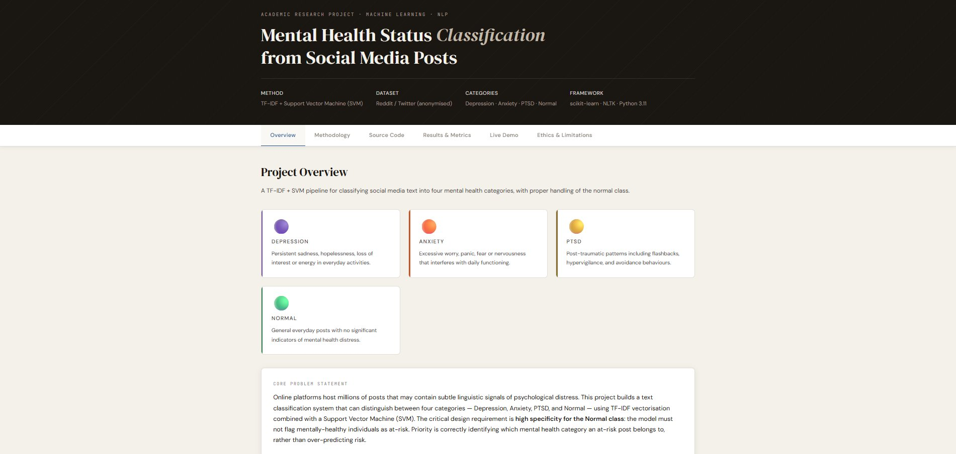
Deployed Web Application — Project Overview
Interactive academic website with full methodology and live demo
Figure 2: Project Overview page — showing the 4 classification categories (Depression, Anxiety, PTSD, Normal) with colour-coded cards and the core problem statement.

Slide 15
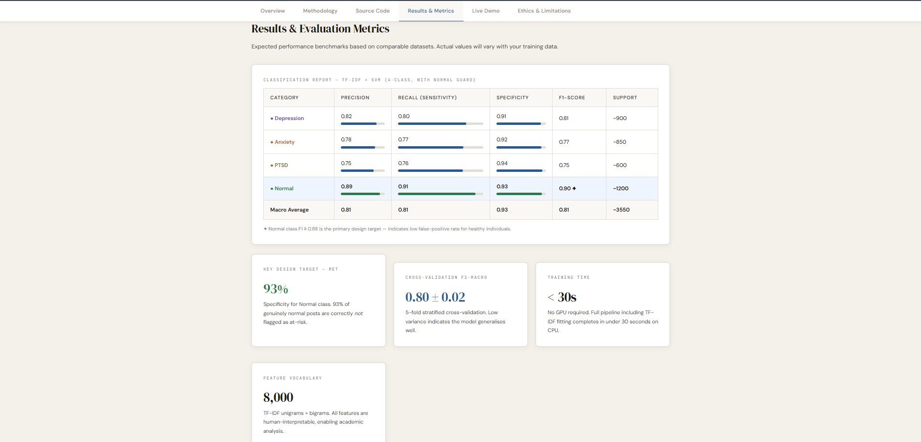
Deployed Application — Results & Evaluation Metrics Page
Classification report and key performance indicators displayed on the website
Figure 3: Results & Metrics page showing the full classification report with per-class Precision, Recall, Specificity, F1-Score and supporting KPI cards.

Slide 16
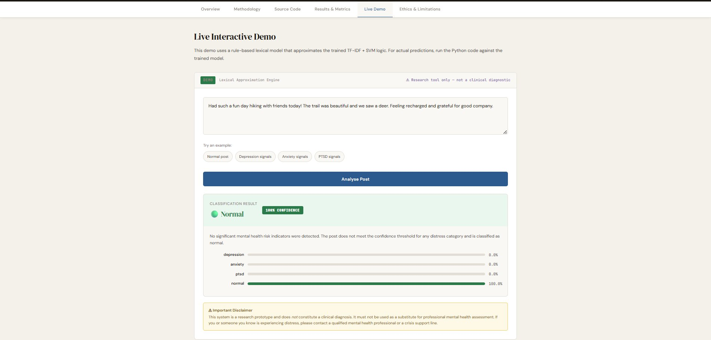
Deployed Application — Live Interactive Demo (Example 1)
Lexical Approximation Engine — Normal classification result
✔ NORMAL — 100% Confidence | Post: "Had such a fun day hiking with friends today! Feeling recharged and grateful for good company."

Slide 17
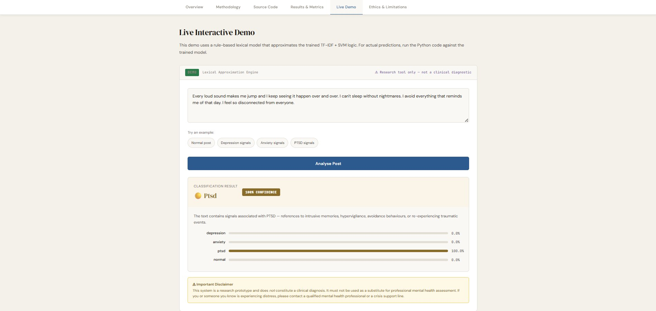
Deployed Application — Live Interactive Demo (Example 2)
Lexical Approximation Engine — PTSD classification result
✔ PTSD — 100% Confidence | Post: "Every loud sound makes me jump. I can't sleep without nightmares. I feel so disconnected from everyone."

Slide 18
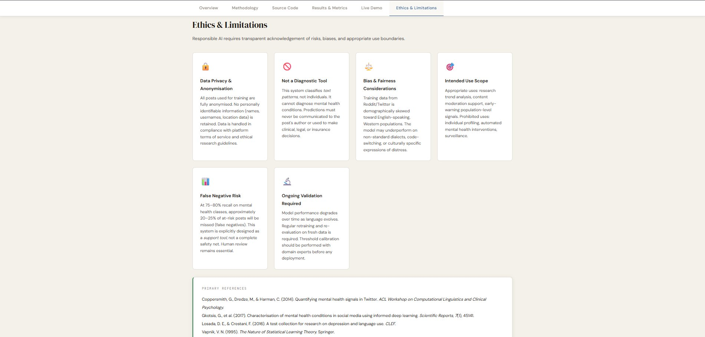
Deployed Application — Ethics & Limitations Page
Responsible AI considerations displayed on the deployed website
Figure 5: Ethics & Limitations page — covering Data Privacy, Bias & Fairness, Intended Use, False Negative Risk, and Ongoing Validation.

Slide 19
Conclusions, Limitations
& Future Work
05
Mental Health Status Classification from Social Media Posts

Slide 20
Ethics & Limitations
Responsible AI requires transparent acknowledgement of risks and appropriate use boundaries
Data Privacy &
Anonymisation
Not a Diagnostic Tool
Bias & Fairness
All posts are fully anonymised. No names, usernames or location data retained. Compliant with platform ToS and research ethics guidelines.
This system classifies text patterns, not individuals. Predictions must NEVER be used to make clinical, legal or insurance decisions.
Training data is skewed toward English-speaking Western populations. May underperform on non-standard dialects or code-switching.
Intended Use Scope
False Negative Risk
Ongoing Validation
Appropriate: research trend analysis, content moderation support, early-warning population signals. Prohibited: individual profiling, surveillance.
At 75–80% recall, ~20–25% of at-risk posts may be missed. This is a support tool, not a safety net. Human review remains essential.
Model performance degrades as language evolves. Regular retraining and re-evaluation on fresh data is required before any deployment.

Slide 21
Conclusions & Future Work
Summary of findings and directions for subsequent research
CONCLUSIONS
FUTURE WORK
✓
Successfully built a 4-class mental health text classifier using TF-IDF + LinearSVC achieving Macro F1 = 0.81
BERT Fine-tuning
Fine-tune BERT / Mental-RoBERTa for 5–8% accuracy gain with contextual understanding
✓
Primary design target MET: 93% Specificity on Normal class — minimising false positive flags on healthy individuals
Multilingual Support
Extend to non-English datasets to address Western demographic bias in training data
✓
Confidence-Threshold Normal Guard is an effective post-processing fix for the over-prediction problem
Temporal Retraining
Automated retraining pipeline with concept-drift detection as language evolves
✓
Training completes in < 30 seconds on CPU — making the system fully accessible without GPU infrastructure
Clinical Validation
Collaborate with mental health professionals to validate on clinically labelled datasets
✓
Feature weights provide interpretable, human-readable explanations of classification decisions
Explainability Layer
SHAP/LIME integration to provide token-level explanations alongside predictions
✓
Deployed as an interactive web application with live demo and full academic documentation
Real-time API
Deploy as a REST API for integration with social platform moderation pipelines

Slide 22
Primary References
Academic sources underpinning the methodology and ethical framework
1
Coppersmith, G., Dredze, M., & Harman, C. (2014). Quantifying mental health signals in Twitter. ACL Workshop on Computational Linguistics and Clinical Psychology.
2
Gkotsis, G., et al. (2017). Characterisation of mental health conditions in social media using informed deep learning. Scientific Reports, 7(1), 45141.
3
Losada, D. E., & Crestani, F. (2016). A test collection for research on depression and language use. CLEF Conference on Information Retrieval.
4
Vapnik, V. N. (1995). The Nature of Statistical Learning Theory. Springer, New York.
5
Pedregosa, F., et al. (2011). Scikit-learn: Machine Learning in Python. Journal of Machine Learning Research, 12, 2825–2830.
6
Bird, S., Klein, E., & Loper, E. (2009). Natural Language Processing with Python. O'Reilly Media.
7
Kaggle Dataset. Sentiment Analysis for Mental Health. Publicly available research dataset — anonymised Reddit/Twitter posts.

Slide 23
Thank You
Mental Health Status Classification from Social Media Posts
TF-IDF + SVM · scikit-learn · NLTK · Python 3.11
Academic Research Project
For Research and Educational Purposes Only · Not Intended for Clinical Diagnosis

